Slide 1
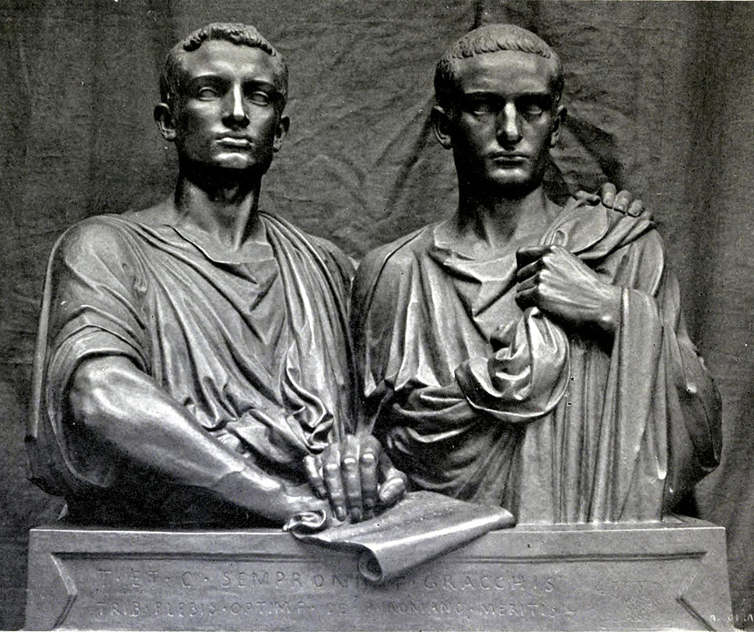
Task One: Explanation (ESSAY)
GOAL/S: Review key P/E/I - historical context
Week 5, Lesson 1

Slide 2
REVIEW – Where are we up to?
Term/Week | Topic/Content | Assessments
T1 - 1 | Roman Society Overview
T1 - 2 - 3 | Roman Soc/Pol/Eco/Religion/Cul
T1 – 4 - 6 | Tiberius and Gaius Gracchus (133 – 121 BCE) | Essay (Week 6 – 10%)
T1 – 7 - 9 | Gaius Marius (133 – 87 BCE) | Source Analysis (Week 9 – 10%)
T2 – 1 - 3 | Sulla (90 – 78 BCE)
T2 – 4 – 5 | EST | EST (Week 4 – 5 – 15%)
T2 – 5 - 6 | Pompey to 66 BCE | Historical Inquiry (Week 5 – 6 – 10%)
T2 - 7 | EXAMS

Slide 3
This Week:
Overview Task 1 and Review of Content
Essay Writing – How to
RELIEF TEACHER – Essay Notes Page (Prep)
RELIEF TEACHER – Essay Notes Page and drafting (Prep)

Slide 4
Task One
Explanation (ESSAY) – Task booklet

Slide 5
MINDMAP
Question 1: Analyse how Tiberius and Gaius Gracchus shaped the period of 133–121 BCE. How did these the brothers contribute to the socio-political landscape of ancient Rome during this time?
Notes:
Thesis Statement: The political reforms and actions of Tiberius and Gaius Gracchus significantly influenced the socio-political landscape of ancient Rome during the period of 133–121 BCE.
Background info: Tiberius and Gaius Gracchus were Roman politicians and reformers who sought to address issues of land distribution, social inequality, and political corruption in the Roman Republic during the tumultuous years of the late 2nd century BCE.
Essay Map: This essay will explore the contributions of Tiberius and Gaius Gracchus to the socio-political landscape of ancient Rome, focusing on their land reforms, political initiatives, and the lasting impact of their actions.
BODY PARAGRAPHS:
1. Tiberius Gracchus' Land Reforms:
Topic Sentence: Tiberius Gracchus initiated land reforms aimed at redistributing land to the plebeians, which challenged the dominance of the senatorial class.
Explanation/Evidence: He proposed the Lex Sempronia Agraria, which aimed to limit the amount of land an individual could possess and redistribute excess land to landless citizens.
Linking Sentence: These reforms exacerbated tensions between the plebeians and the senatorial elite, laying the groundwork for future socio-political conflict.
2. Gaius Gracchus' Political Initiatives:
Topic Sentence: Gaius Gracchus expanded upon his brother's reforms by advocating for further political and social changes.
Explanation/Evidence: He introduced legislation such as the Lex Frumentaria, which provided subsidized grain for the urban poor, and proposed measures to extend Roman citizenship to allied communities.
Linking Sentence: Gaius Gracchus' initiatives aimed to alleviate social inequality and strengthen the political power of the plebeians, but they also faced fierce opposition from conservative factions within the Roman Senate.
3. Lasting Impact and Legacy:
Topic Sentence: Despite their eventual downfall, the Gracchi brothers' reforms left a lasting impact on Roman politics and society.
Explanation/Evidence: Their efforts brought issues of social injustice and political corruption to the forefront of Roman discourse, inspiring future reformers and revolutionaries.
Linking Sentence: The Gracchi brothers' legacy serves as a testament to the complex interplay between class conflict, political ambition, and societal change in the history of ancient Rome.
CONCLUSION: In conclusion, the contributions of Tiberius and Gaius Gracchus to the socio-political landscape of ancient Rome during the period of 133–121 BCE were profound and far-reaching. Through their land reforms, political initiatives, and enduring legacy, the Gracchi brothers left an indelible mark on Roman history, shaping the course of events and influencing the trajectory of the Roman Republic.

Slide 6
ESSAY
Question 1: Analyse how Tiberius and Gaius Gracchus shaped the period of 133–121 BCE. How did these the brothers contribute to the socio-political landscape of ancient Rome during this time?
Notes:
Thesis Statement: The political reforms and actions of Tiberius and Gaius Gracchus significantly influenced the socio-political landscape of ancient Rome during the period of 133–121 BCE.
Background info: Tiberius and Gaius Gracchus were Roman politicians and reformers who sought to address issues of land distribution, social inequality, and political corruption in the Roman Republic during the tumultuous years of the late 2nd century BCE.
Essay Map: This essay will explore the contributions of Tiberius and Gaius Gracchus to the socio-political landscape of ancient Rome, focusing on their land reforms, political initiatives, and the lasting impact of their actions.
BODY PARAGRAPHS:
1. Tiberius Gracchus' Land Reforms:
Topic Sentence: Tiberius Gracchus initiated land reforms aimed at redistributing land to the plebeians, which challenged the dominance of the senatorial class.
Explanation/Evidence: He proposed the Lex Sempronia Agraria, which aimed to limit the amount of land an individual could possess and redistribute excess land to landless citizens.
Linking Sentence: These reforms exacerbated tensions between the plebeians and the senatorial elite, laying the groundwork for future socio-political conflict.
2. Gaius Gracchus' Political Initiatives:
Topic Sentence: Gaius Gracchus expanded upon his brother's reforms by advocating for further political and social changes.
Explanation/Evidence: He introduced legislation such as the Lex Frumentaria, which provided subsidized grain for the urban poor, and proposed measures to extend Roman citizenship to allied communities.
Linking Sentence: Gaius Gracchus' initiatives aimed to alleviate social inequality and strengthen the political power of the plebeians, but they also faced fierce opposition from conservative factions within the Roman Senate.
3. Lasting Impact and Legacy:
Topic Sentence: Despite their eventual downfall, the Gracchi brothers' reforms left a lasting impact on Roman politics and society.
Explanation/Evidence: Their efforts brought issues of social injustice and political corruption to the forefront of Roman discourse, inspiring future reformers and revolutionaries.
Linking Sentence: The Gracchi brothers' legacy serves as a testament to the complex interplay between class conflict, political ambition, and societal change in the history of ancient Rome.
CONCLUSION: In conclusion, the contributions of Tiberius and Gaius Gracchus to the socio-political landscape of ancient Rome during the period of 133–121 BCE were profound and far-reaching. Through their land reforms, political initiatives, and enduring legacy, the Gracchi brothers left an indelible mark on Roman history, shaping the course of events and influencing the trajectory of the Roman Republic.

Slide 7
MINDMAP
Question 2: Examine the effects of continuity and change in the period of Tiberius and Gaius Gracchus.
How did their reforms challenge or reinforce existing structures and traditions within Roman society?
Discuss the impact on the political, economic, and social aspects of the Roman Republic.
Notes:
INTRODUCTION:
Thesis Statement: The period of Tiberius and Gaius Gracchus witnessed a complex interplay of continuity and change within Roman society, as their reforms both challenged and reinforced existing structures and traditions, profoundly impacting the political, economic, and social fabric of the Roman Republic.
Background info: Tiberius and Gaius Gracchus were Roman politicians who sought to address issues of land distribution, social inequality, and political corruption during the late 2nd century BCE.
Essay Map: This essay will examine the effects of continuity and change in the period of Tiberius and Gaius Gracchus, exploring how their reforms challenged or reinforced existing structures and traditions within Roman society, and discussing the impact on the political, economic, and social aspects of the Roman Republic.
BODY PARAGRAPHS:
1. Challenging Political Structures:
Topic Sentence: Tiberius and Gaius Gracchus challenged traditional political structures by advocating for populist reforms that empowered the plebeian class.
Explanation/Evidence: Tiberius' land reforms, such as the Lex Sempronia Agraria, challenged the senatorial elite's control over land distribution, while Gaius' political initiatives aimed to expand citizenship rights and increase the power of the people.
Linking Sentence: These reforms destabilized the established power dynamics within the Roman Senate, leading to increased political polarization and conflict.
2. Reinforcing Economic Traditions:
Topic Sentence: Despite their efforts at reform, the Gracchi brothers also reinforced certain economic traditions within Roman society.
Explanation/Evidence: Their land reforms aimed to restore the traditional Roman ideal of small, independent farmers, reinforcing the agrarian basis of the Roman economy.
Linking Sentence: However, these reforms faced resistance from entrenched economic interests, highlighting the tension between tradition and change in Roman economic practices.
3. Social Impact and Transformation:
Topic Sentence: The reforms of Tiberius and Gaius Gracchus had a profound impact on the social structure of Roman society.
Explanation/Evidence: By addressing issues of land distribution and social inequality, their reforms sought to alleviate the plight of the urban poor and marginalized populations.
Linking Sentence: However, these reforms also exacerbated social tensions and divisions, as seen in the violent conflicts that erupted between supporters and opponents of the Gracchi brothers' reforms.
CONCLUSION: In conclusion, the period of Tiberius and Gaius Gracchus exemplifies the complex interplay between continuity and change within Roman society. While their reforms challenged traditional political structures and sought to address pressing social and economic issues, they also reinforced certain aspects of Roman tradition and values. The legacy of the Gracchi brothers underscores the enduring tensions between reformist impulses and conservative resistance in the history of the Roman Republic, shaping the course of events and leaving a lasting impact on subsequent developments in Roman politics, economy, and society.

Slide 8
ESSAY
Question 2: Examine the effects of continuity and change in the period of Tiberius and Gaius Gracchus.
How did their reforms challenge or reinforce existing structures and traditions within Roman society?
Discuss the impact on the political, economic, and social aspects of the Roman Republic.
Notes:
INTRODUCTION:
Thesis Statement: The period of Tiberius and Gaius Gracchus witnessed a complex interplay of continuity and change within Roman society, as their reforms both challenged and reinforced existing structures and traditions, profoundly impacting the political, economic, and social fabric of the Roman Republic.
Background info: Tiberius and Gaius Gracchus were Roman politicians who sought to address issues of land distribution, social inequality, and political corruption during the late 2nd century BCE.
Essay Map: This essay will examine the effects of continuity and change in the period of Tiberius and Gaius Gracchus, exploring how their reforms challenged or reinforced existing structures and traditions within Roman society, and discussing the impact on the political, economic, and social aspects of the Roman Republic.
BODY PARAGRAPHS:
1. Challenging Political Structures:
Topic Sentence: Tiberius and Gaius Gracchus challenged traditional political structures by advocating for populist reforms that empowered the plebeian class.
Explanation/Evidence: Tiberius' land reforms, such as the Lex Sempronia Agraria, challenged the senatorial elite's control over land distribution, while Gaius' political initiatives aimed to expand citizenship rights and increase the power of the people.
Linking Sentence: These reforms destabilized the established power dynamics within the Roman Senate, leading to increased political polarization and conflict.
2. Reinforcing Economic Traditions:
Topic Sentence: Despite their efforts at reform, the Gracchi brothers also reinforced certain economic traditions within Roman society.
Explanation/Evidence: Their land reforms aimed to restore the traditional Roman ideal of small, independent farmers, reinforcing the agrarian basis of the Roman economy.
Linking Sentence: However, these reforms faced resistance from entrenched economic interests, highlighting the tension between tradition and change in Roman economic practices.
3. Social Impact and Transformation:
Topic Sentence: The reforms of Tiberius and Gaius Gracchus had a profound impact on the social structure of Roman society.
Explanation/Evidence: By addressing issues of land distribution and social inequality, their reforms sought to alleviate the plight of the urban poor and marginalized populations.
Linking Sentence: However, these reforms also exacerbated social tensions and divisions, as seen in the violent conflicts that erupted between supporters and opponents of the Gracchi brothers' reforms.
CONCLUSION: In conclusion, the period of Tiberius and Gaius Gracchus exemplifies the complex interplay between continuity and change within Roman society. While their reforms challenged traditional political structures and sought to address pressing social and economic issues, they also reinforced certain aspects of Roman tradition and values. The legacy of the Gracchi brothers underscores the enduring tensions between reformist impulses and conservative resistance in the history of the Roman Republic, shaping the course of events and leaving a lasting impact on subsequent developments in Roman politics, economy, and society.

